Slide 1
Transport API (TAPI) 2.0 Features Overview
June 12, 2017

Slide 2
TAPI 2.0 Features/Updates Overview
TAPI (Re)Naming Updates
Information Model
Yang Data schema
Service Interface Point / Service End Point Enhancements
Topology Refactoring changes
Connectivity Refactoring changes
Node Constraints support
Resilience/Protection/Switch support
OAM support
Alarm/TCA support
Multilayer use case enhancements
Termination model description
ODU model updates (triggered by latest ITU-T draft)
Och → OTSi model transformation (triggered by latest ITU-T draft)
TAPI Reference Implementation – added ONOS/mininet example

Slide 3
TAPI YANG Data Schema Naming Updates
All identifiers (grouping, enumeration, leaf, etc) naming convention changed from UpperCamelCase/lowerCamelCase to lisp-case
Added suffixes
class grouping → -c
complex DataType grouping → -d
enumeration/DataType typedef → -t
extensible enum literal identity → -id
Added support for extensible enumeration mapping
Non-leaf enumerations mapped to base identity & typedef
Enhanced/simplified Specification model
<Specify> stereotype with a target property mapping to yang augment statement
MEF NRM/NRP leveraging TAPI & being defined as a Specification model
Numerous bug-fixes for yang compilation & validation
TAPI YANG successfully passes validation in YangCatalog
Deferred config/state model separation

Slide 4
TAPI Generic & Topology Refactoring/Naming updates
Renamed Tapi model/module to TapiCommon
Refactored the TAPI Context definition pattern by defining the Context container in TapiCommon and augmenting it with specific context definitions (e.g. TopologyContext, ConnectivityContext, NotificationContext, etc) in each of the TAPI module
Deleted the extensions attribute from GlobalClass and LocalClass allowing for specifications to augment any TAPI class
Deleted the label attribute from the GlobalClass
Deleted the TerminationDirection attribute from SIP, NEP, CEP classes
Deleted the TeLink class and using the Link in the Path definition
Merged LinkPort into NodeEdgePoint
Added NodeConstraints Model (next slide)

Slide 5
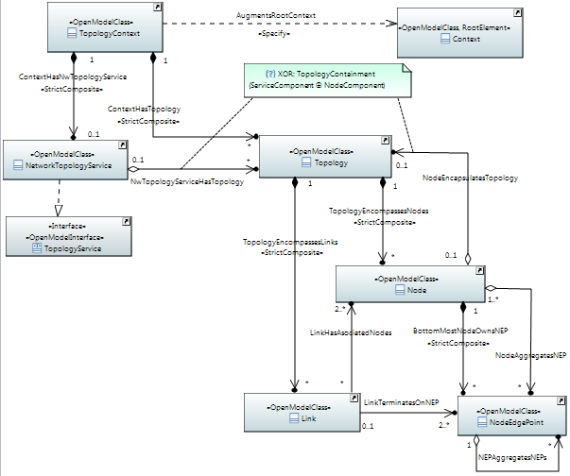
TAPI Topology Skeleton

Slide 6
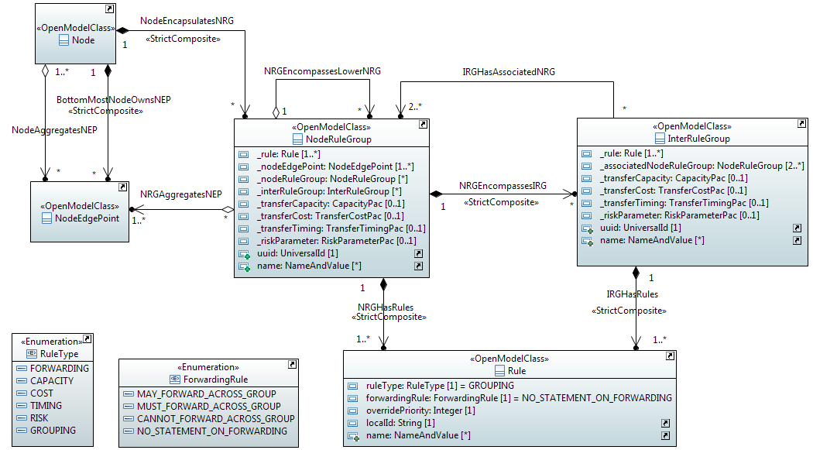
TAPI Node Constraints Model

Slide 7
ServiceInterfacePoint / ServiceEndPoint (SIP/CSEP) Enhancements and other Generic changes
TAPI 1.0 ServiceEndPoint renamed to ServiceInterfacePoint (SIP)
Based on request from MEF to better align with similarly named artifacts and to avoid confusion between the models
TAPI 1.0 ConnectivityServicePort renamed to ConnectivityServiceEndPoint (CSEP)
Similar naming updates to PathServicePort and VirtualNetworkServicePort
Added CapacityPac to ServiceInterfacePoint
Allows for TAPI provider to advertize capacity information in the SIP
Added CapacityPac and LayerProtocol to ConnectivityServiceEndPoint
Called serviceLayer in TAPI 1.0 of type LayerProtocolName
Allows for TAPI client to specify capacity & layer-specific information per individual end-point of ConnectivtyService request

Slide 8
TAPI Connectivity Refactoring Changes
Redefined connection’s Route as a series of ConnectionEndPoints rather than a series of lower-level Connections
Connection decomposition/partitioning is captured by direct ConnectionHasLowerLevelConnections association
Also added ConnectionSupportsLink association
Merged ConnectionPort into ConnectionEndPoint
Split the ConnectivityConstraint class into ConnectivityConstraint and TopologyConstraint
Renamed the serviceLayer attribute to preferredTransportLayer
Added includePath/excludePath, includeLink/excludeLink, includeNode/excludeNode and corouteInclusion constraints
Added the Resilience Model (next slide)
Added the Oam model as a separate model/module that augments Connectivity (next slide)

Slide 9
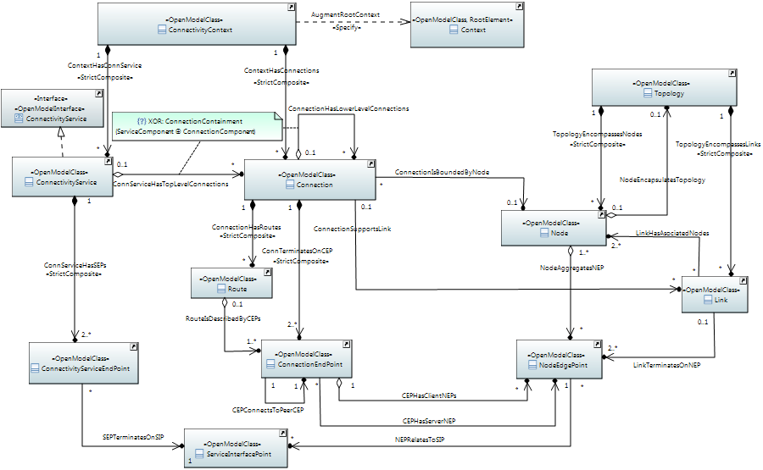
TAPI Connectivity Skeleton

Slide 10
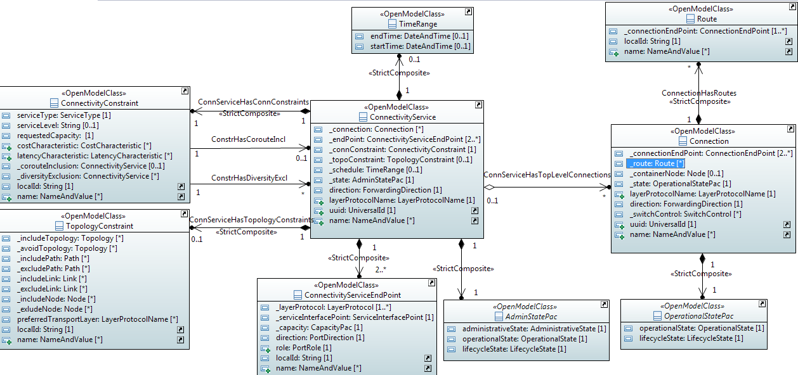
TAPI Connectivity Model

Slide 11
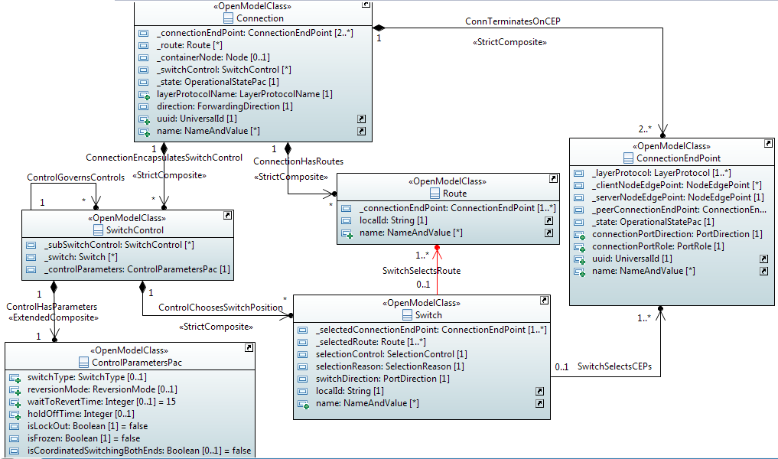
TAPI Resilience Model

Slide 12
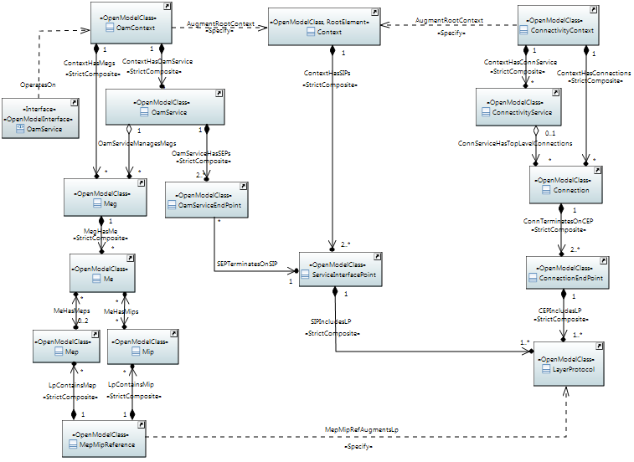
TAPI OAM Skeleton

Slide 13
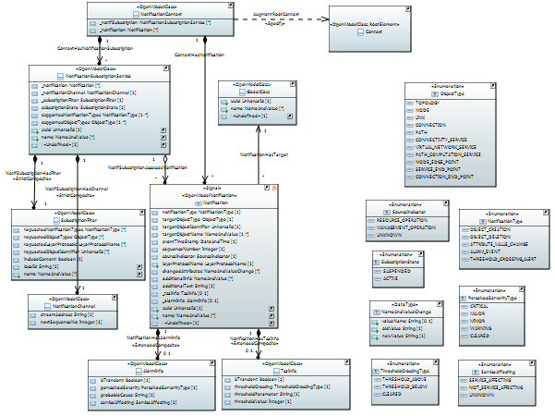
TAPI Notification Model

